Slide 1
Phân đoạn Pneumothorax
(tràn khí màn phổi)
Trần Hoàng Vũ
Lưu Minh Quân
Trần Tấn Thành
<number>

Slide 2
Nội dung
Giới thiệu bài toán
Hướng giải quyết
Kết quả
Demo
2

Slide 3
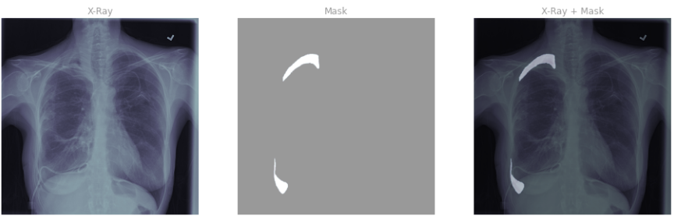
Giới thiệu bài toán
Phân đoạn được đâu là phần tràn khí màng phổi từ hình ảnh X-quang
Dữ liệu bao gồm có 12955 hình X-quang từ 12047 bệnh nhân và nhãn tương ứng
Hình ảnh không có nhãn tức là không bị chứng tràn khí màng phổi
3
Notes:
It’s important to note that intrusion detection systems and intrusion prevention systems are both important parts of network integrity and include concepts that you may want to consider for IT security actions and decisions. Sometimes the systems overlap, and sometimes they’re combined or referred to together as IDPS.

Slide 4
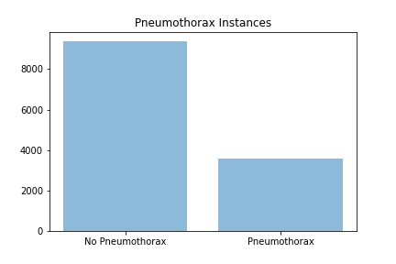
Giới thiệu bài toán
Dataset
4
Notes:
all intrusion prevention begins with intrusion detection. But security systems can go one step further and act to stop ongoing and future attacks. When an IPS detects an attack, it can reject data packets, give commands to a firewall, and even sever a connection.

Slide 5

Giới thiệu bài toán
Evaluation
Dice coefficient: so sánh trên từng pixel giữa ảnh phân đoạn dự đoán và ảnh phân đoạn ground-truth the công thức
5
Notes:
An IDS monitors your network for possible dangerous activity, including malicious acts and violations of security protocols. When such a problem is detected, an IDS alerts the administrator but doesn’t necessarily take any other action.
Signature-based: Signature-based IDS relies on a preprogrammed list of known attack behaviors. It is similar to antivirus software
Signature-based IDS is popular and effective but is only as good as its database of known signatures. This makes it vulnerable to new attacks. Plus, attackers can and do frequently disguise their attacks to avoid common signatures that will be detected. Also, the most thorough signature-based IDS will have huge databases to check against, meaning big bandwidth demands on your system.
Anomaly-based: Anomaly-based IDS begins with a model of normal behavior on the network, then alert an admin anytime it detects any deviation from that model of normal behavior. Anomaly-based IDS begins at installation with a training phase where it “learns” normal behavior. AI and machine learning have been very effective in this phase of anomaly-based systems.
However, they can set off many false positives, since they don’t always distinguish well between attacks and benign anomalous behavior

Slide 6
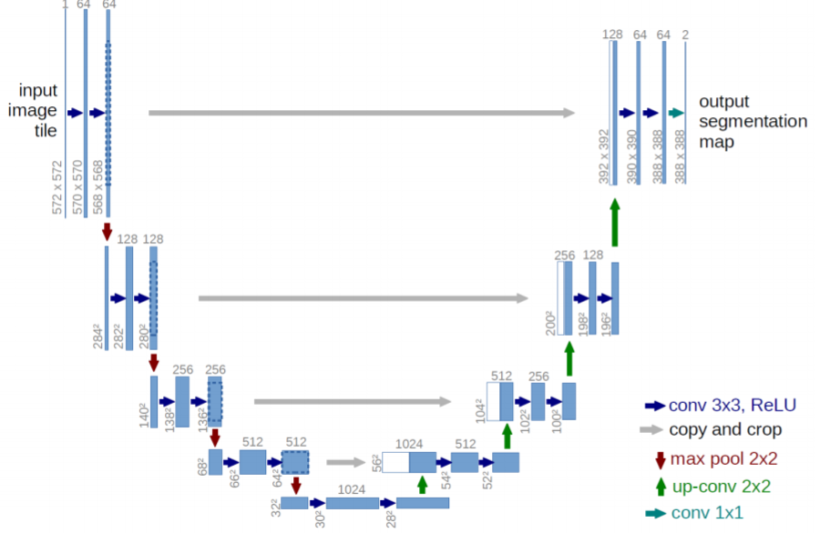
Hướng giải quyết
Phương pháp sử dụng U-Net
5

Slide 7
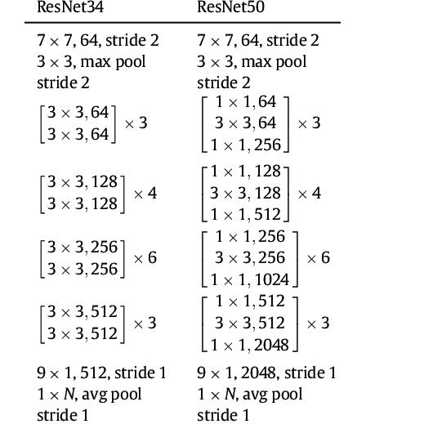
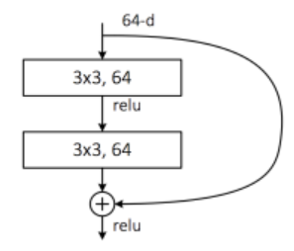
Hướng giải quyết
U-Net với encoder dựa trên ResNet
5

Slide 8
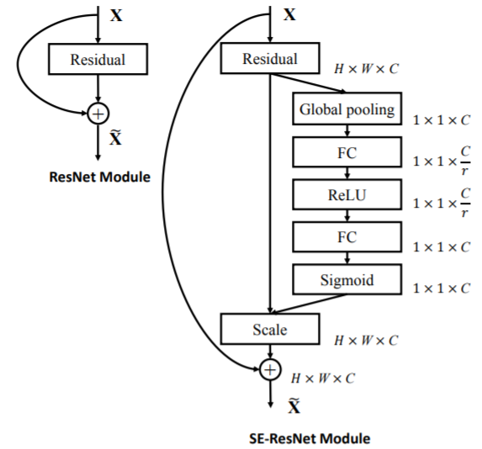
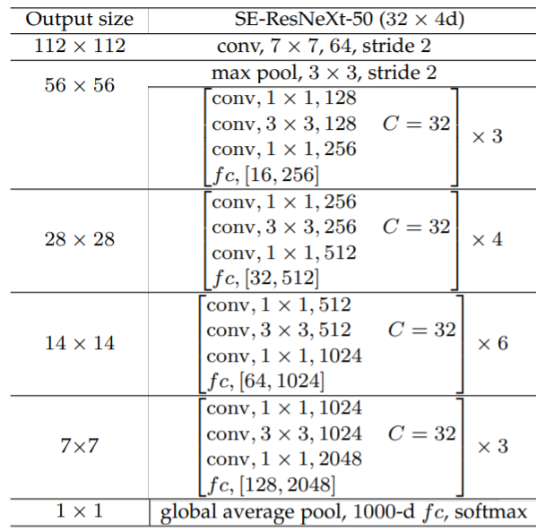
Hướng giải quyết
U-Net với encoder dựa trên SE-ResNext-50
5

Slide 9

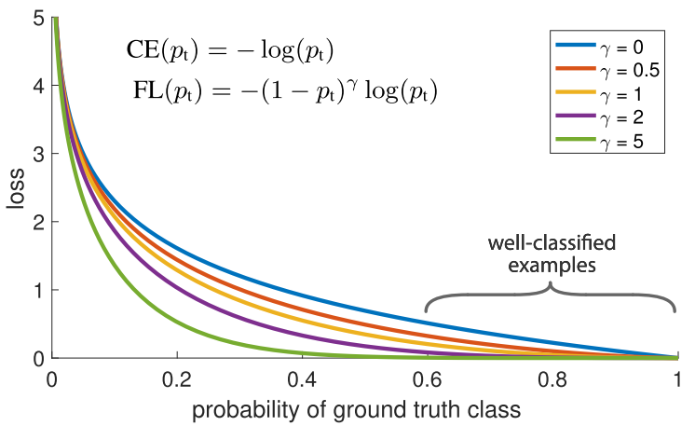
Hướng giải quyết
Combo loss
Binary Cross entropy
Dice loss
Focal loss
5

Slide 10
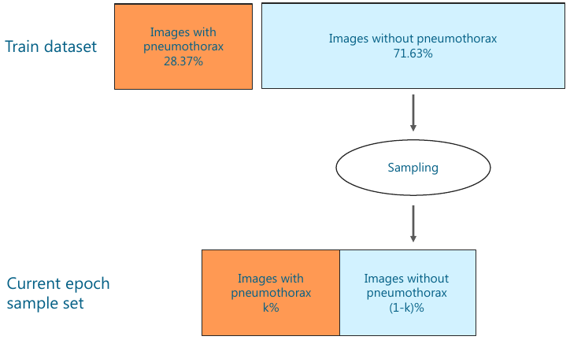
Hướng giải quyết
Input data
Sliding sample rate
10
Notes:
Statistics base: statistical properties such as mean and variance on normal transaction to build the normal profile [4]. The statistical tests are employed to determine whether the observed transaction deviates from the normal profile.
Knowledge-based techniques base: extract the knowledge from the specific attacks and system vulnerabilities. This knowledge can be further used to identify the intrusions or attacks happening in the network or system.
Machine learning-based techniques are broadly classified as Bayesian approaches, support vector machines, neural networks, fuzzy logic, and genetic algorithms. Their key advantage is flexibility, adaptability, and capture of interdependencies.

Slide 11
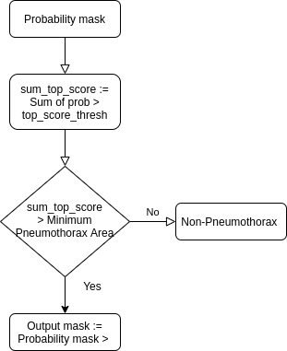
Hướng giải quyết
Post Processing
Top Score Threshold
Minimum Pneumothorax Area
Bottom Score Threshold
10

Slide 12
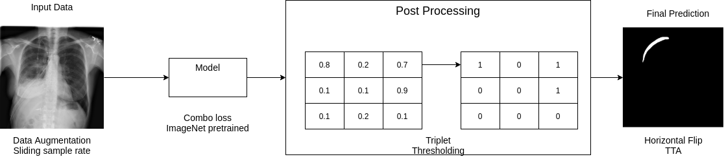
Hướng giải quyết
Pipeline bài toán
10

Slide 13
Kết quả
Model | Validation accuracy | Test Accuracy | Triplet threshold
U-Net with ResNet-34 | 78.6% | 60% | (0.75, 1000, 0.3)
U-Net with ResNet-50 | 86.8% | 88.2% | (0.75, 2000, 0.4)
U-Net with SE-ResNext-50 | 87.2% | 89.4% | (0.6, 3000, 0.4)
10

Slide 14
Demo
10

Slide 15
Q&A
15

